Slide 1
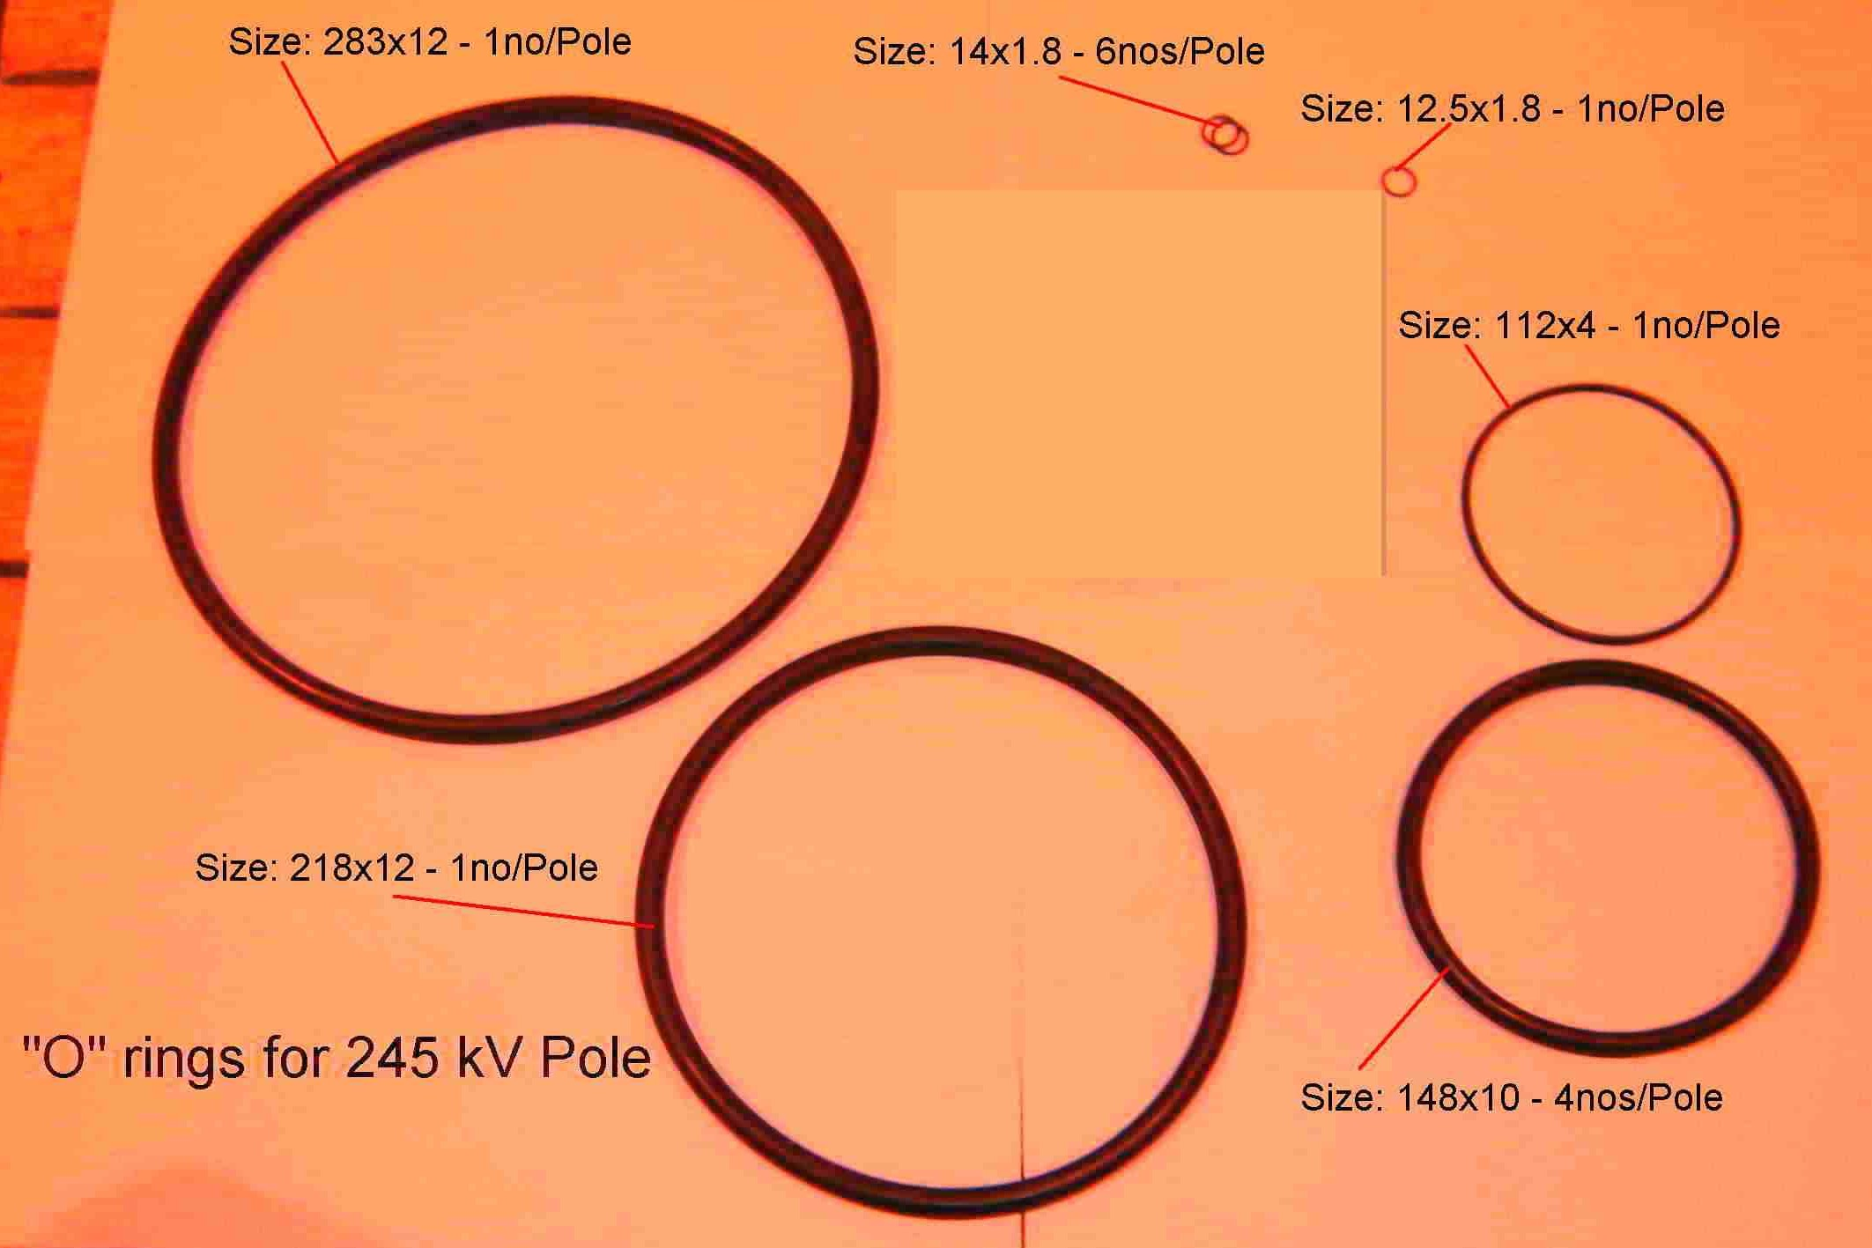
SIEMENS
HVCB SPARES
“O” rings set for each pole for 245KV CB
S4799246001

